Slide 1
Abstract Datatypes
DSA

Slide 2
Definition
Abstract data types (ADTs) are descriptions of data structures that specify their behavior without going into details about how they are implemented.
They define what operations can be performed on the data structure and what the expected behavior of those operations should be.
This allows programmers to focus on the behavior of the data structure without worrying about implementation details, making it easier to understand and modify code.
ADTs are often used in object-oriented programming to define classes and interfaces.

Slide 3
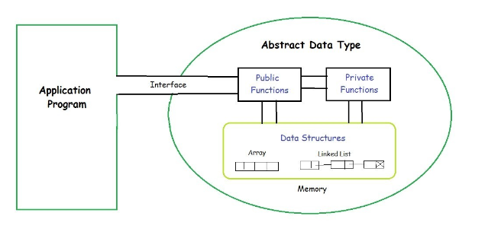
Understanding through diagrams

Slide 4
What datatype can do not how it will do
The user of data type does not need to know how that data type is implemented, for example, we have been using Primitive values like int, float, char data types only with the knowledge that these data type can operate and be performed on without any idea of how they are implemented.
So a user only needs to know what a data type can do, but not how it will be implemented. Think of ADT as a black box which hides the inner structure and design of the data type. Now we’ll define three ADTs namely List ADT, Stack ADT, Queue ADT.

Slide 5
ADT
For example, a stack is an ADT that defines a last-in, first-out (LIFO) data structure with two operations: push, which adds an element to the top of the stack, and pop, which removes the top element from the stack.
The behavior of these operations is well-defined, but the implementation details (such as how the stack is actually stored in memory) are not specified by the ADT.

Slide 6
ADT
By defining data structures in terms of ADTs, programmers can separate the interface of a data structure from its implementation.
This makes it easier to change the implementation without affecting the rest of the program, and it also makes it easier to reason about the behavior of the data structure without getting bogged down in implementation details.
ADTs are often used in object-oriented programming languages to define classes and interfaces.

Slide 7
List ADT
The data is generally stored in key sequence in a list which has a head structure consisting of count, pointers and address of compare function needed to compare the data in the list.
The data node contains the pointer to a data structure and a self-referential pointer which points to the next node in the list.

Slide 8
List ADT
The List ADT Functions is given below:
get() – Return an element from the list at any given position.
insert() – Insert an element at any position of the list.
remove() – Remove the first occurrence of any element from a non-empty list.
removeAt() – Remove the element at a specified location from a non-empty list.
replace() – Replace an element at any position by another element.
size() – Return the number of elements in the list.
isEmpty() – Return true if the list is empty, otherwise return false.
isFull() – Return true if the list is full, otherwise return false.

Slide 9
Stack ADT
In Stack ADT Implementation instead of data being stored in each node, the pointer to data is stored.
The program allocates memory for the data and address is passed to the stack ADT.
The head node and the data nodes are encapsulated in the ADT. The calling function can only see the pointer to the stack.
The stack head structure also contains a pointer to top and count of number of entries currently in stack.

Slide 10
Stack ADT
push() – Insert an element at one end of the stack called top.
pop() – Remove and return the element at the top of the stack, if it is not empty.
peek() – Return the element at the top of the stack without removing it, if the stack is not empty.
size() – Return the number of elements in the stack.
isEmpty() – Return true if the stack is empty, otherwise return false.
isFull() – Return true if the stack is full, otherwise return false.

Slide 11
Queue ADT
The queue abstract data type (ADT) follows the basic design of the stack abstract data type.
Each node contains a void pointer to the data and the link pointer to the next element in the queue. The program’s responsibility is to allocate memory for storing the data.

Slide 12
Queue ADT
enqueue() – Insert an element at the end of the queue.
dequeue() – Remove and return the first element of the queue, if the queue is not empty.
peek() – Return the element of the queue without removing it, if the queue is not empty.
size() – Return the number of elements in the queue.
isEmpty() – Return true if the queue is empty, otherwise return false.
isFull() – Return true if the queue is full, otherwise return false.

Slide 13
Features of ADT:
Abstraction: The user does not need to know the implementation of the data structure.
Better Conceptualization: ADT gives us a better conceptualization of the real world.
Robust: The program is robust and has the ability to catch errors.

